Slide 1
Identify Question
The Scientific Method
Do Background Research
Construct Hypothesis
Test with an Experiment
Accept or Reject Hypothesis
Report Results

Slide 2
SCIENCE FAIR – Wednesday, January 6th
Project due Monday, January 4th
Judging in Learning Commons 9-11 am

Slide 3
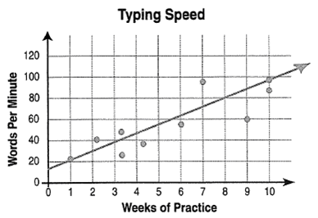
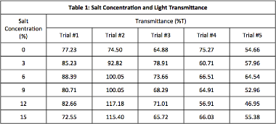
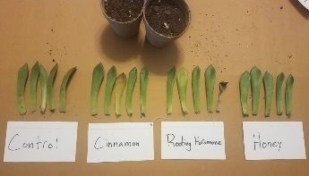
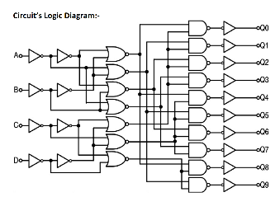
ALL Students will complete their final project by EDITING THIS SLIDE.
Click “View” and “Zoom” to insert your information.
Due Monday, Jan. 4th – NO EXCEPTIONS!
Project will be sent to judges prior to judging.
STATEMENT OF PURPOSE (WHY IS PROJECT IMPORTANT)
HYPOTHESIS
SUMMARY OF PROCEDURES
ABSTRACT
TITLE
DATA and OBSERVATIONS
Graphs
Charts/Data Tables
Photos that help promote understanding
Diagrams
DATA ANALYSIS
CONCLUSIONS
FUTURE STUDIES (OPTIONAL)

Slide 4
Wed. January 6th - Judging in Learning Commons 9-11 am
Judging will be conducted through a Zoom meeting.
Students will be assigned a judging time.
Students will have 15 minutes to present and answer questions.
Judges will have already viewed project board.

Slide 5
STATEMENT OF PURPOSE (WHY IS PROJECT IMPORTANT)
HYPOTHESIS
SUMMARY OF PROCEDURES
ABSTRACT
TITLE
DATA and OBSERVATIONS
Graphs
Charts/Data Tables
Photos that help promote understanding
Diagrams
DATA ANALYSIS
CONCLUSIONS
FUTURE STUDIES (OPTIONAL)

Slide 6
STATEMENT OF PURPOSE (WHY IS PROJECT IMPORTANT)
HYPOTHESIS
SUMMARY OF PROCEDURES
ABSTRACT
Should be descriptive and creative
TITLE
DATA and OBSERVATIONS
Graphs
Charts/Data Tables
Photos that help promote understanding
Diagrams
DATA ANALYSIS
CONCLUSIONS
FUTURE STUDIES (OPTIONAL)

Slide 7
STATEMENT OF PURPOSE (WHY IS PROJECT IMPORTANT)
HYPOTHESIS
SUMMARY OF PROCEDURES
ABSTRACT
TITLE
DATA and OBSERVATIONS
Graphs
Charts/Data Tables
Photos that help promote understanding
Diagrams
DATA ANALYSIS
CONCLUSIONS
FUTURE STUDIES (OPTIONAL)
Should be clear, concise, and well worded. Should include
your independent and dependent variables. Try “if, then,
because….”

Slide 8
Identifies the purpose of the experiment or the
problem the experiment was designed to solve.
STATEMENT OF PURPOSE (WHY IS PROJECT IMPORTANT)
HYPOTHESIS
SUMMARY OF PROCEDURES
ABSTRACT
TITLE
DATA and OBSERVATIONS
Graphs
Charts/Data Tables
Photos that help promote understanding
Diagrams
DATA ANALYSIS
CONCLUSIONS
FUTURE STUDIES (OPTIONAL)

Slide 9
STATEMENT OF PURPOSE (WHY IS PROJECT IMPORTANT)
HYPOTHESIS
SUMMARY OF PROCEDURES
ABSTRACT
TITLE
DATA and OBSERVATIONS
Graphs
Charts/Data Tables
Photos that help promote understanding
Diagrams
DATA ANALYSIS
CONCLUSIONS
FUTURE STUDIES (OPTIONAL)
Experimental procedures should be outlined in
chronological order. Be clear.

Slide 10
STATEMENT OF PURPOSE (WHY IS PROJECT IMPORTANT)
HYPOTHESIS
SUMMARY OF PROCEDURES
ABSTRACT
TITLE
DATA and OBSERVATIONS
Graphs
Charts/Data Tables
Photos that help promote understanding
Diagrams
DATA ANALYSIS
CONCLUSIONS
FUTURE STUDIES (OPTIONAL)
Rows and columns should have headings. Data should be
totaled and averaged. Tables should be computer generated.

Slide 11
STATEMENT OF PURPOSE (WHY IS PROJECT IMPORTANT)
HYPOTHESIS
SUMMARY OF PROCEDURES
ABSTRACT
TITLE
DATA and OBSERVATIONS
Graphs
Charts/Data Tables
Photos that help promote understanding
Diagrams
DATA ANALYSIS
CONCLUSIONS
FUTURE STUDIES (OPTIONAL)
Should include a descriptive title, labels on x and y axis,
units of measurement. Graphs should be computer generated.

Slide 12
STATEMENT OF PURPOSE (WHY IS PROJECT IMPORTANT)
HYPOTHESIS
SUMMARY OF PROCEDURES
ABSTRACT
TITLE
DATA and OBSERVATIONS
Graphs
Charts/Data Tables
Photos that help promote understanding
Diagrams
DATA ANALYSIS
CONCLUSIONS
FUTURE STUDIES (OPTIONAL)

Slide 13
Data Analysis and Discussion –
Any calculations done with the data (such as finding rates of change) should be included here.
Graphs presented should be discussed.
Identify the strength of relationship between your variables. What trends exist in your data?
Apply your background research to experimental findings. Did you get the result you expected? Discuss.
Are there other explanations for your results that you had not considered or observed?
Were there experimental errors in your data collection, experimental design or observations?
Did experimental results display accuracy and precision? How were your results affected by uncontrolled events?
NOTICE: Understanding errors is a key skill scientists must develop.
In addition, reporting that there was no apparent relationship between the variables tested can be valuable information.
This is just as much a ‘discovery’ as if there was a relationship between variables

Slide 14
STATEMENT OF PURPOSE (WHY IS PROJECT IMPORTANT)
HYPOTHESIS
SUMMARY OF PROCEDURES
ABSTRACT
TITLE
DATA and OBSERVATIONS
Graphs
Charts/Data Tables
Photos that help promote understanding
Diagrams
DATA ANALYSIS
CONCLUSIONS
FUTURE STUDIES (OPTIONAL)

Slide 15
Conclusion –
The conclusion summarizes what you discovered based on your experimental results.
The conclusion re-states the hypothesis and indicates whether the data supports it. Be specific, do not generalize. Never introduce anything in the conclusion that has not already been discussed.
Discuss the real world applications of your experimental results.

Slide 16
STATEMENT OF PURPOSE (WHY IS PROJECT IMPORTANT)
HYPOTHESIS
SUMMARY OF PROCEDURES
ABSTRACT
TITLE
DATA and OBSERVATIONS
Graphs
Charts/Data Tables
Photos that help promote understanding
Diagrams
DATA ANALYSIS
CONCLUSIONS
FUTURE STUDIES (OPTIONAL)
Include a description of plans for exploring ideas for future experiments.
Explain how methods could be improved. What would you do differently if you repeated this project?

Slide 17
STATEMENT OF PURPOSE (WHY IS PROJECT IMPORTANT)
HYPOTHESIS
SUMMARY OF PROCEDURES
ABSTRACT
TITLE
DATA and OBSERVATIONS
Graphs
Charts/Data Tables
Photos that help promote understanding
Diagrams
DATA ANALYSIS
CONCLUSIONS
FUTURE STUDIES (OPTIONAL)
A short summary of your project. Needs to be on “Official” Florida State Science and Engineering Fair form. Find it on the Landrum science fair website http://www.lms.stjohns.k12.fl.us/sciencefair/

Slide 18
STATEMENT OF PURPOSE (WHY IS PROJECT IMPORTANT)
HYPOTHESIS
SUMMARY OF PROCEDURES
ABSTRACT
TITLE
DATA and OBSERVATIONS
Graphs
Charts/Data Tables
Photos that help promote understanding
Diagrams
DATA ANALYSIS
CONCLUSIONS
FUTURE STUDIES (OPTIONAL)
A well-selected photo(s) could REALLY help judges understand your project. “A picture’s worth a thousand words.”

Slide 19
STATEMENT OF PURPOSE (WHY IS PROJECT IMPORTANT)
HYPOTHESIS
SUMMARY OF PROCEDURES
ABSTRACT
TITLE
DATA and OBSERVATIONS
Graphs
Charts/Data Tables
Photos that help promote understanding
Diagrams
DATA ANALYSIS
CONCLUSIONS
FUTURE STUDIES (OPTIONAL)

