Slide 1
Identify Question
The Scientific Method
Do Background Research
Construct Hypothesis
Test with an Experiment
Accept or Reject Hypothesis
Report Results

Slide 2
How much longer do I need to attend the Tuesday meetings?
Until your paperwork is submitted, corrected, re-submitted
and approved.
Once approved check Schoology messages frequently for important due dates and instructions.
Also check Sci. Fair website http://www.lms.stjohns.k12.fl.us/sciencefair/

Slide 3
So far, you should have:
Submitted a Student Information form.
Selected a Topic.
Started a Project Journal.
Conducted Background Research and created a Bibliography with 5 sources.
Visited the Rules Wizard and determined the forms you need.
Created a detailed Research Plan
Completed all Forms with the help of your parent.

Slide 4
Projects to be reviewed by Landrum’s Scientific Review Committee (SRC) and/or Institutional Review Board (IRB) :
Human Subjects
Vertebrate Animals
Microorganisms
Hazardous Activities (Chemical Reactions, Electricity, Fire)
All other projects do not require special approval and can begin once paperwork is reviewed and corrected.

Slide 5
What needs to be submitted for project approval?
Detailed Research Plan

Slide 6
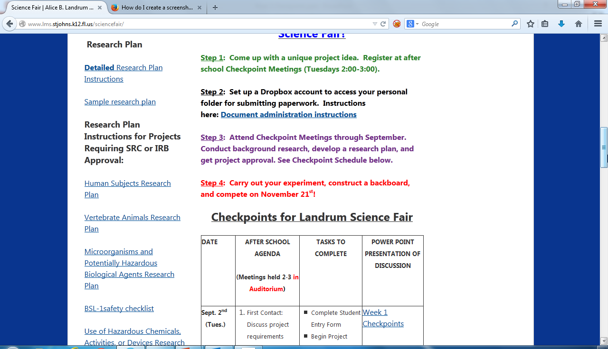
Please be sure that you follow the Detailed Research Plan Instructions!

Slide 7
"Battery." Encyclopedia Britannica. 1990.
"Best Batteries." Consumer Reports Magazine 32 Dec. 1994: 71-72.
Booth, Steven A. "High-Drain Alkaline AA-Batteries." Popular Electronics 62 Jan. 1999: 58.
Brain, Marshall. "How Batteries Work." howstuffworks. 1 Aug. 2006 <http://home.howstuffworks.com /battery.htm>.
"Cells and Batteries." The DK Science Encyclopedia. 1993.
Dell, R. M., and D. A. J. Rand. Understanding Batteries. Cambridge, UK: The Royal Society of Chemistry, 2001.
"Learning Center." Energizer. Eveready Battery Company, Inc. 1 Aug. 2006 <http://www.energizer.com /learning/default.asp>.
"Learning Centre." Duracell. The Gillette Company. 31 July 2006 <http://www.duracell.com /au/main/pages/learning-centre-what-is-a battery.asp>
What needs to be submitted for project approval?
Detailed Research Plan
Bibliography with 5 sources

Slide 8
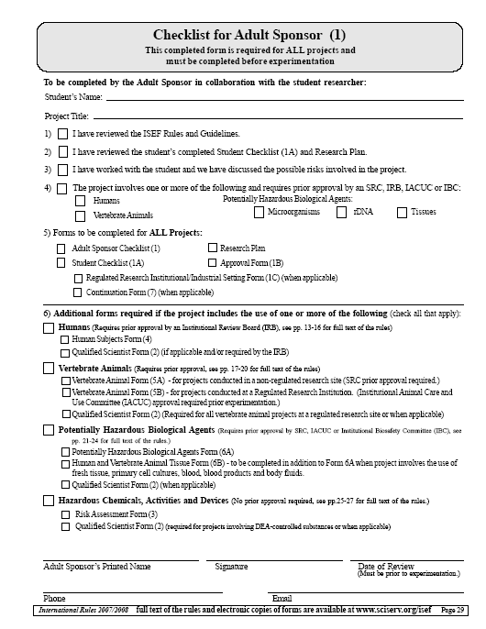
What needs to be submitted for project approval?
Detailed Research Plan
Bibliography with 5 sources
Forms 1, 1A, and 1B

Slide 9
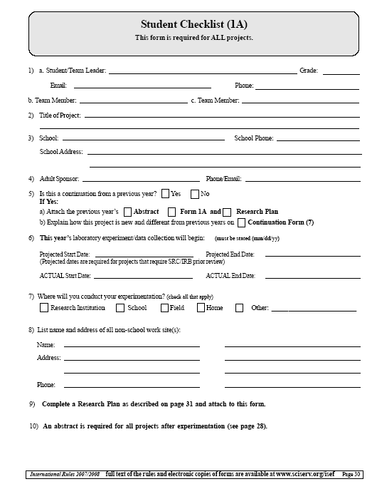
What needs to be submitted for project approval?
Detailed Research Plan
Bibliography with 5 sources
Forms 1, 1A, and 1B

Slide 10
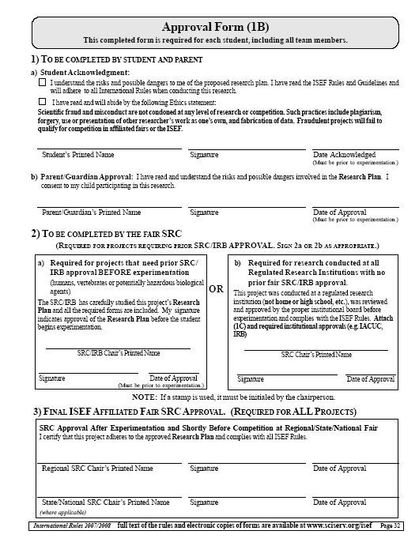
What needs to be submitted for project approval?
Detailed Research Plan
Bibliography with 5 sources
Forms 1, 1A, and 1B

Slide 11
What needs to be submitted for project approval?
Detailed Research Plan
Bibliography with 5 sources
Forms 1, 1A, and 1B
ADDITIONAL forms for projects requiring SRC/IRB approval

Slide 12
How Will the Approval Process Proceed?
Step 1: Submit copies of research plan and forms to Mr. Anzelmo for initial review.
Step 2: Wait for paperwork to be returned to you with comments from Mr. Anzelmo.
Step 3: Make corrections and revisions to research plan and paperwork.
Step 4: Re-submit corrected paperwork to Mr. Anzelmo
Step 5: Repeat steps 1-4 until project is approved.
YOU CANNOT BEGIN EXPERIMENTATION UNTIL PROJECT IS APPROVED.

Slide 13
For projects with Human Subjects:
For project approval, you will need to submit ONE copy of YOUR Human Informed Consent Form for review
Can be found under All Science Fair Forms on Landrum Science fair website
AFTER approval, you will need a copy of this form for EVERY participant you test. They can be PAPER copies, signed in ink, and kept in your binder.

