Slide 1
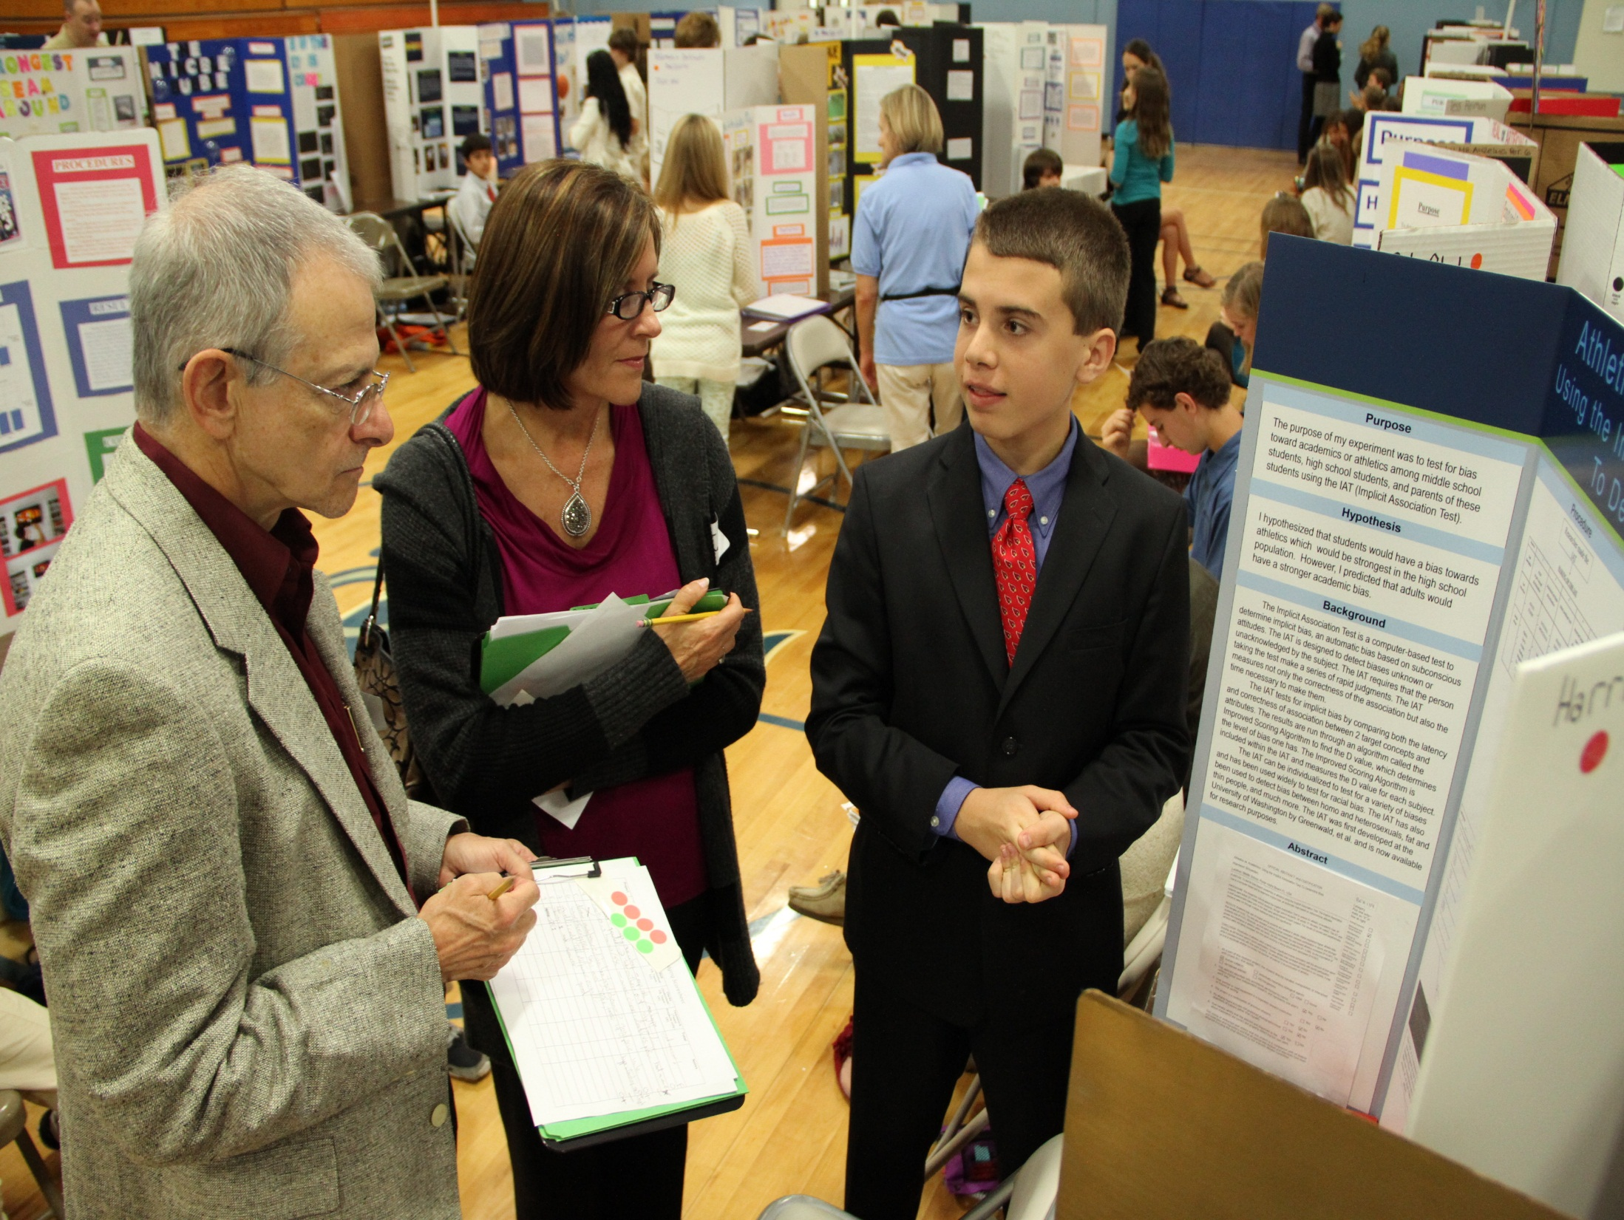
Science Fair
2024-25

Slide 2
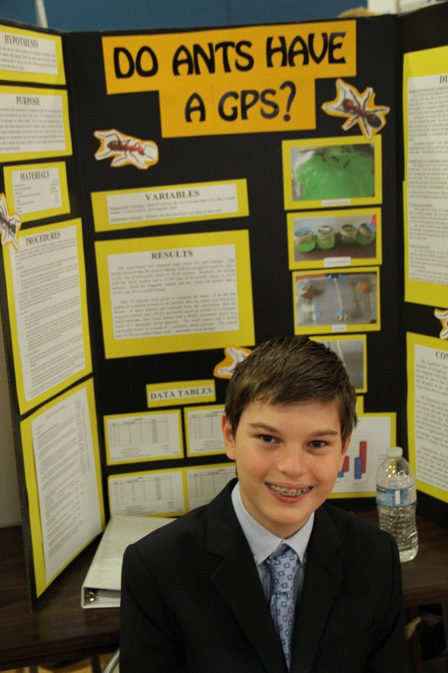
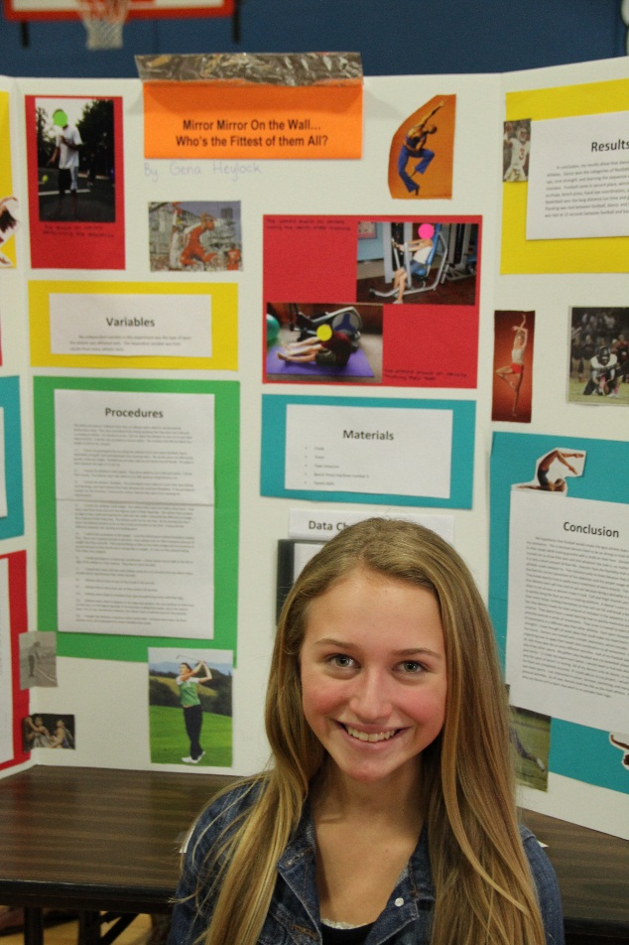
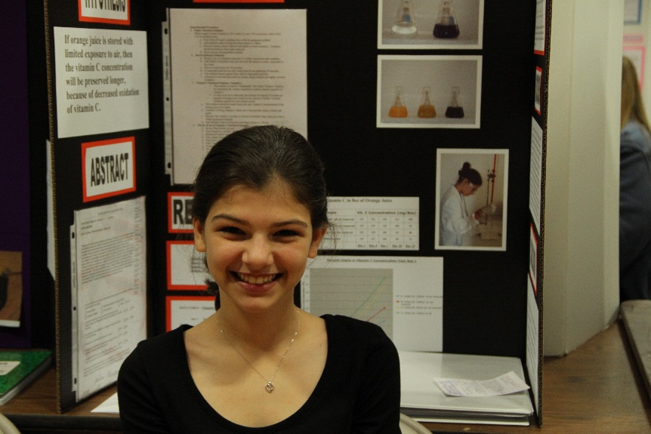
The Landrum Middle School Science Fair is affiliated with:
The St. Johns County Science Fair
Florida State Science and Engineering Fair (SSEF)
Intel International Science and Engineering Fair (ISEF)

Slide 3
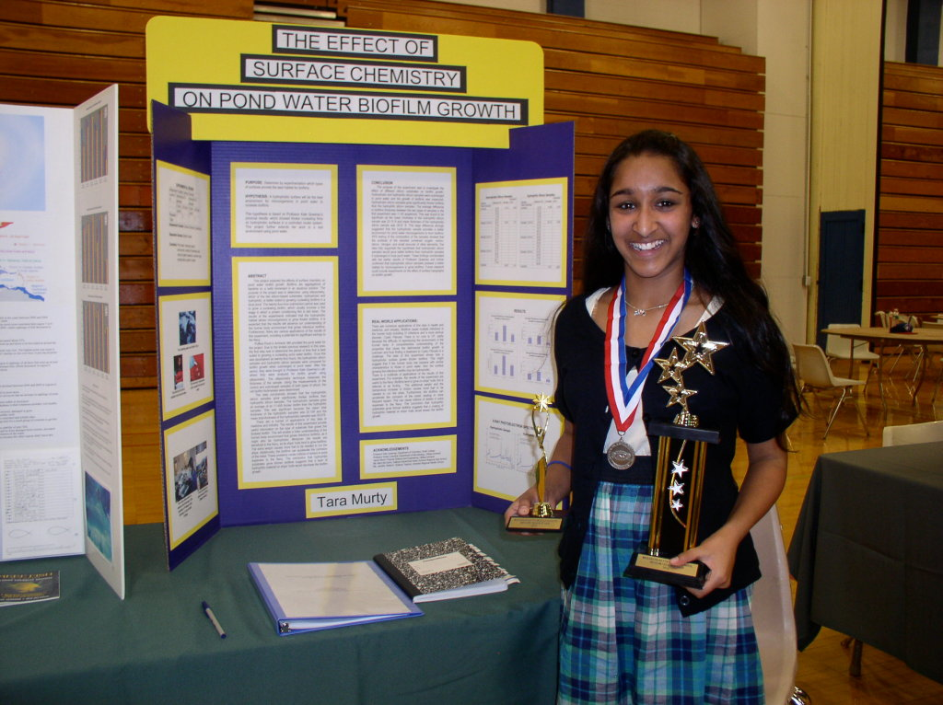
Parts of the Science Fair Project
Backboard –
Presents your entire experiment
Project Binder Contains paperwork, background research, and project report.
Project Journal - A diary of your project. A record of everything you did.

Slide 4
Project Journal
EVERY student needs to keep a project journal
EVERYTHING you do should be recorded in
your project journal (not just your
experimental data).
DATE every entry – extremely important!!!
Do NOT tear out pages, use white out, or scribble out mistakes.
Draw ONE line (mistack) through any mistakes.
Your journal should document the process of selecting a topic, background research, rough drafts of your Research Plan, your data – EVERYTHING! -- START MAKING ENTRIES TODAY!
Mr. Anzelmo
Science Fair

Slide 5
Sample Entry
08/27/24
Attended first Science Fair meeting. Discussed project components and met Mr. Anzelmo.
Will need to visit science fair website: http://www.lms.stjohns.k12.fl.us/sciencefair/
My first topic idea deals with methods to reduce plastic consumption by using...

Slide 6
What are the Judges Looking For?
Projects that:
Are Meaningful
Have real world applications
Have a clear purpose
Solve a real-world problem
Address an issue in your community
Are challenging
Steer clear of commonly-done projects with obvious outcomes (like ones you find on internet sites like ScienceBuddies.com)
Models and demonstrations, while educational, are not Science Fair projects!

Slide 7
Students often develop projects in:
Animal Sciences
Behavioral and Social Sciences
Biochemistry
Medical and Health Sciences
Chemistry
Earth and Environmental Sciences
Engineering
Environmental Engineering
Materials Science
Mathematics
Microbiology
Physics and Astronomy
Plant Sciences

Slide 8
Where Do I Begin?
Topic selection is the most challenging part!
Pursue topics that interest you. You encounter many testable subjects each day. Topics don’t have to be too serious or difficult.
Use current events to inspire you.
Address questions of local or regional concern.
Try to answer an unanswered question, solve a problem, invent or improve something.

Slide 9
Can I Start Experimenting?
NO
You must first:
1) Conduct background research and create a bibliography
2) Create a detailed Research Plan
3) Complete all of the Official ISEF forms needed for your project and receive project approval
These tasks must be completed BEFORE any experimentation can begin!!!
Winning students can advance to the St. Johns County Science fair and the Florida State Fair, and potentially win monetary awards and college scholarships!

Slide 10
What Next?
Get a Project Journal and start making entries.
Fill out the STUDENT INFORMATION FORM
3. Visit the Landrum Science Fair website and familiarize yourself with upcoming due dates
4. Start looking for sources of background information for your project, which is our topic next week!

Slide 11
What are the Judges Looking For?
Your project should:
Use quantifiable (measureable) variables.
Have measurable results (time, distance, capacity, temperature, frequency, changes in rates, scale rankings…...)
Product tests should be avoided unless you test the chemical or physical properties of specific ingredients.
* Your project must address why there may be a difference in the effectiveness between products based on chemical or physical properties.

